Slide 2
FINANCIAL AND FISCAL COMMISSION Municipal Viability Colloquim 29 May 2015

Slide 3
INTRODUCTION
Municipal viability is a complex concept and needs in depth discussion on various issues affecting municipal viability.
The demarcation process in KwaZulu-Natal has afforded an opportunity to reflect on the consequences of re-demarcations and their effect on the viability of municipalities.
If not managed properly there could be major unintended consequences emanating from such mergers, thereby affecting municipal governance negatively.

Slide 4
These principles would be relevant in determining municipal viability in most municipalities and should not only be confined to merging municipalities.
This presentation does not propose to give an exhaustive view on municipal viability but addresses selected areas as identified during a re-demarcation process .
A brief background on the demarcation process being undertaken in KZN will be outlined.
The focus of the presentation will therefore also mainly focus on the smaller rural municipalities and the challenges faced in terms of municipal viability

Slide 5
BACKGROUND
Details of demarcations announced in 2014
- Five mergers have been approved in KZN
- Two split amalgamations have been approved in KZN
- One further merger could be approved after the re-opening of the re-determinations in KZN

Slide 6
A Municipal Demarcation Transition Grant was introduced in the 2015 Budget, in line with recommendations from the FFC.
An amount of R1.8m was provided for each affected municipality within a Change Management Committee to implement the Restructuring process:-
- To develop new organograms, work study, preparation of IDPs, amalgamation of accounting systems, etc.

Slide 7
RESTRUCTURING PROCESS IN KWA-ZULU NATAL
The following structures were put in place to manage the Restructuring process:-
Provincial Transformation Committee to determine policies, guidelines and dispute resolutions.
Membership from Sector Departments within Cogta, Provincial Treasury, Traditional Affairs, Salga, Unions

Slide 8
Political Change Management Committees to manage the process at local level with the affected municipalities.
Membership: District Mayor (Chair), Mayors, Speakers, Exco members, Amakhosi from the affected municipalities.
Technical Change Management Committees to provide technical and administrative reports on all aspects of the restructuring process to the Political CMC’s.
Membership: District Municipal Manager (Chair), MMs, HODs, Union Reps from affected municipalities.

Slide 9
NEED TO CONSIDER ADDITIONAL FUNDING
The Municipal Demarcation Transition Grant is only allocated to those major re-demarcations that were already approved when the Budget was tabled.
At the time the grant was allocated there was no detailed analysis on which to base the allocations. As detailed work has now been done on the mergers underway it is possible to give more accurate estimates of the costs involved. Allocations for the newly re-demarcated areas as well as the current re-demarcations should be considered in the present financial year.

Slide 10
An amount of R1.8m as presently allocated is totally inadequate to fund the Restructuring process.
Should additional funding not be made available, the Restructuring process will be severely compromised as essential programmes will not be able to be implemented.
This will seriously affect the viability of the new municipality.

Slide 11
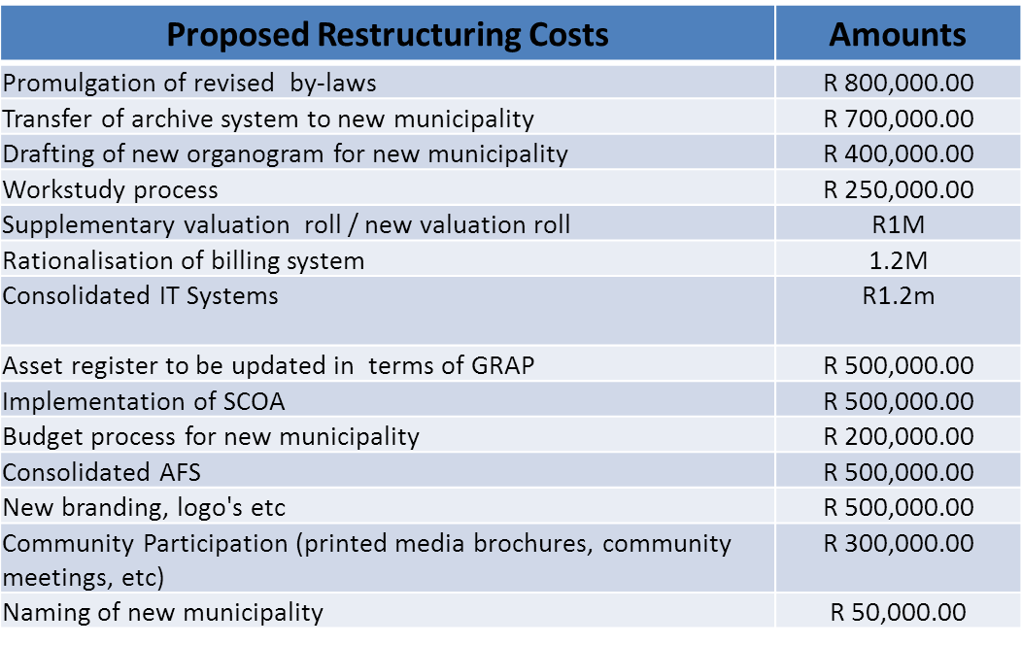
KWAZULU-NATAL ESTIMATED COST OF MERGERS - Extensive cost estimates have been work shopped with CMCs.
- The following are costs determinable as the present restructuring process unfolds per CMC:-

Slide 12
The total cost per CMC ,excluding HR costs, amounts to R8.2m.
(R56M in total)
Preliminary unverified costs for pay parity costs of staff to the highest graded municipality are estimated to be in excess of R25 m per annum
The above financial implications are presented to illustrate the effects of a re-demarcation if not adequately funded.
This in turn affects the viability of the newly established municipality.
HR Costs to be determined | Amounts
Pay parity after placement | TBD
Re-location costs of staff | TBD
Retrenchment costs | TBD
Salary after placement (Re-grading) | TBD
Leave pay provisions and other salary related costs | TBD
Increased operational costs after amalgamation | TBD
Cost related to the Determination of the new Head Office (Amalgamated towns vary between 60 and 100 kms apart) | TBD

Slide 13
COMMUNITY VIABILITY
Community viability focusses on the demographic, social and economic aspects of the community.
The more rural the community, the less financial contribution can be expected from a financial, fiscal point of view, the greater the expectations for being provided with basic services .
These factors in turn influence the financial viability of a municipality.

Slide 14
MUNICIPAL VIABILITY
Municipal viability needs to be achieved for any newly established municipality.
The mergers are intended to ensure rationalisation of services, strengthening of capacity and financial viability.
Financial viability needs to be attained, meaning the fiscal state of the municipality.
If this cannot be attained the municipality will fail.
Referring specifically to the HR costs resultant from the amalgamation costs to bring about parity in salary costs equal to the higher graded municipality as set out above, if not funded externally, will severely compromise the financial viability of the merged municipality.

Slide 15
Factors Influencing Financial Viability of Mergers
Increased salary costs due to the fact that all staff will now have to be paid at the higher grade.
The amalgamation would probably lead to a re-grading of the municipality, resulting in higher salaries.
Re-location costs for staff to be re-located to the new Head Office.
In most cases the merging municipalities have small or no rates base to fund operating and capital expenditure and depend on equitable share allocations from National Treasury.
Non payment for services provided.
Increased operational costs emanating from the mergers.

Slide 16
Factors Influencing Governance Viability
Capacity constraints with regard to Senior Management appointments at smaller rural municipalities.
This is evidenced by the degeneration of basic service delivery within these towns.
Institutional instability within these municipalities (currently 5 Municipal Managers suspended at these affected municipalities).
Bloated staff structures and organograms to conform with legislative requirements.

Slide 17
Possible Solutions
Re-introduction of District Management Areas in terms of the Municipal Structures Act
This would lead to a substantial reduction in operating costs with regard to salaries and councillor allowances
This would require a political intervention which would possibly not be acceptable.
However, the rural municipal environment needs a drastic re-think in terms of governance and institutional matters.

Slide 18
Several statutory requirements governing municipal administration in rural areas need to be amended to ensure sustainable local government within these areas.

Slide 19
Thank you

Slide 20
3rd Floor, Southern Life Plaza
271 Church Street Pietermaritzburg, 3200
Tel: +27(0) 33 355 6405
Fax: +27(0) 33 355 6559
Cell: 082 7820708
E-mail: andre.els@kzncogta.gov.za
Website: www.kzncogta.gov.za

