Slide 1
Submission On New Development Bank and Contingency Reserve Arrangement
Standing Committee On Finance, 27 May 2015
For an Equitable Sharing of National Revenue

Slide 2
Roadmap
Background: Rationale and Assessment of NDB and CRA
Issues for Standing Committee on Finance
Funding and Budget Process
Cost Benefit Analysis
Intergovernmental Fiscal Relations
Other Dimensions – South African Reserve Bank

Slide 3
Overview Of Initiative
The BRICS proposals establish two separate institutions, the Contingency Reserve Arrangement (CRA) and the New Development Bank (NDB)
The CRA is a virtual institution whereas the NDB will be an institution that will be established
The NDB will have its headquarters in Shanghai and a regional office in Johannesburg
What is the context of these proposals?
Major gap in development finance to fund long-term infrastructure and sustainable development
The departure by US from expansionary fiscal policy led to large outflows from emerging economies and significant decline in exchange rates
This experience indicated potential vulnerability of emerging economies to shocks emanating from developed countries

Slide 4
New Development Bank – Rationale
Bargaining Chip or Partner to MDBs?
Snub to IFIs? Way to dodge ‘hoops’ imposed by IFIs? Value-added of being run by ‘local/Southern’ actors? A way of attracting funds / investment and keeping it in the BRICS? Complementary?
Why international and coordinated approach?
International dimension was critical because of lack of private sector financing
Coordination is critical because of massive cross-country externalities:
Trade and financial integration carry the effect of both the crisis and the crisis response across borders
Competition for a common pool of private resources (global savings and liquidity

Slide 5
New Development Bank – Local Vs Foreign Currency
Foreign vs local currency: the new initiative
Why?
Reduces systemic risks associated with FX lending to unhedged borrowers
Contingency reserve arrangement to protect against volatility and dependence on IMF
To protect from volatility, and IMF programme stigma, activations are secret
Encourages domestic saving and investment – the bank
Why now?
Significant post-crisis common ground
Regulators moving forcefully against FX
Post-crisis macro conditions start to make local currency a more realistic proposition
Shift in global geo-economic power and relations

Slide 6
Constraint
Like all other banks, NDB must still ensure its own commercial viability. And it must do so when a large part of the resources it lends would be mobilised from the market
Contingent Liability: While guarantees from the governments of its shareholding countries would improve the institution’s rating and reduce its borrowing costs, those costs will have to be borne somewhere by guarantor
All socially relevant concerns financed will need to yield at least a return adequate to cover costs and deliver at least a nominal profit otherwise will not be financed

Slide 7
III. Issues For Standing Committee of Finance

Slide 8
Funding and Budget Process
NDB would have an equity stake drawn from each member country, guarantees as well as some sort of credit line up to a threshold (forex reserve) which would be more of a contingent liability
Articles of Agreement contain self executing clauses. This means that once the agreements come into force they will automatically bring the institutions into existence
The equity stake would have to be budgeted for over the MTEF (across Treasury's vote, DIRCO, DTI and/or DED), with some sort of arrangement to deal with the currency fluctuations (currency reserve fund)
The contingent liability portion could be handled as other provisions are currently handled

Slide 9
Equity: First Call On Budget or Not?
South Africa is liable for US$2 billion in respect of paid-in shares
There is no compelling reason why this equity funding should be a first charge of the revenue fund
It should be factored into the normal budget process which is the proposal
If it by-passes the budget process, then legislation will have to be enacted by Parliament to exempt it from the national revenue fund
The FFC is of the view that funding should come from the national share since it is a foreign policy/international finance function
Contributions will be factored into the normal budget process

Slide 10
Contingent Liability: First Call On Budget or Not?
South Africa is liable for US$5 billion in respect of callable shares under CRA (virtual pool)
Need not be part of the budget – similar Government commitments are reflected as ‘Provisions’. Provisions are defined as liabilities for which the payment date/amount is uncertain and are reflected in the statistical tables section of the annually published Budget Review
The FFC’s view is that contingent liability could be funded by a ring fenced fund (like the unemployment insurance fund but just foreign currency denominated) and/or from the contingency reserve.
Between these two, preference is for the latter as its better suited to deal with unforeseen changes
Proposed arrangements are that Contingent liability will sit on National Treasury books

Slide 11
Contingent Liability: First Call On Budget or Not [Cont..]?
In relation to the contingent liability side (credit lines, currency reserves), National Treasury typically does not ring-fence special funding arrangements – this is covered by the general policy reserve, just like SAA and other parastatal guarantees
There are, however, certain international benchmarks e.g. if it is forex denominated contingent liability then it should be no more than (for example) 10% of the country's forex reserves, if it is domestically denominated then it should be related to the asset base etc.
What Parliament should do is ensure that National Treasury reports on these contingent liabilities at least every 6 months to ensure that they are contained and risk is managed. If this is not done, then the country's sovereign rating could be compromised
Management of Assets and Liabilities is a core function of NT. The liabilities position will be reported on 6 monthly through the Budget Review, ENE and MTEF.

Slide 12
Cost Benefit Analysis?
BRICS Formation:
Benefits: lower costs of domestic trade, larger domestic market, FDI
Cost: living with people with different cultures or races, competition from imports, malpractices (e.g. labour in other countries)
Equilibrium: optimal size where benefits exceed costs?
Uneven BRICS effects in regions within a nation
Across cities, municipalities
Across provinces and regions
Across countries
Before and after the membership of BRICS
Channels: Not through pride of national culture, or other related political ideologies (favours) but through trade and IG Relations

Slide 13
Objective: Predict the welfare/wellbeing impacts of the NDB on South Africa
Impacts (BRICS)
Export prices/demand
Import prices
FDI
Foreign aid/Loans etc
Remittances
Channels to households
Consumer prices
Producer prices
Input prices
Employment
Remittances
Household welfare
Consumption (food, etc.)
Caloric intake
School participation
Labour
Access to health services
BRIC economy
Export prices/demand
National economy
Government
Import prices
Consumer prices
Input prices
Producer prices
Employment
Transferts privés
FDI
Foreign aid
Household
Welfare: consumption, caloric intake, schooling, labour, health
Remittances

Slide 14
Verdict on Cost Benefit Analysis of New Development Bank
What we have done thus far is the conceptual
The quantification of the CBA – almost impossible to do unless
the New Development Bank's lending and project selection criteria are known (minimum hurdle rates and Return on Investment for example)
If South African proposals have to compete with other BRICS country proposal for a limited pool of funds, there is no knowing at this stage how many would be successful
South Africa’s ability to secure funding would still be dependent on the country's ability to "package" these projects in a way which would be attractive, despite the concessionary nature of the finance involved
Government in better position to advise on project preparation provided for, especially measures to ensure that projects are ready for financing.

Slide 15
Verdict on Cost Benefit Analysis of New Development Bank [Cont.]
Whether the potential benefits are realised, depends on:
operational efficiency (and the operational arrangements and funding of the New Development Bank is not clear) and
clear and rational (rather than purely politically motivated) lending criteria.
This is also crucial for achieving a net crowding in rather than crowding out of private investment
This concern may weigh heaviest with South Africa because we have the most developed financial system and Parliament must watch this
The final issue is that while the NDB is supposed to be complementary to China's New Asia development bank, it is not clear what this means in practice?

Slide 16
IGFR and New Development Bank:
……Conceptual
New Development Bank
Central government
Para-statal org. (SOEs and SOCs)
Non-governmental organisations, Unions
Provinces
Regional govt authorities
Firms
Local Govts
Communities

Slide 17
Verdict on IGFR Impact of New Development Bank
How will this affect the provinces and municipalities in South Africa?
Because no province or municipality can borrow in foreign currency (constitution, Borrowing Powers Act and PFMA) it would have to go through national anyway and be on-lended in South African currency (much like the Gautrain scheme)
The NDB Articles of Agreement also allow the option of financing certain projects in local currencies
To this end, debt issuance in local capital markets can help avoid currency mismatch arising out of such project funding, and help to develop nascent capital markets of municipal debt
Modalities of local bond issues must be developed in conjunction with retail investor awareness and education programmes
Therefore, it will be another source of capital grant funding but it would depend on the nature of the projects being proposed

Slide 18
Other Dimensions – South African Reserve Bank
The NDB, because of its international mandate, would of course fall completely outside South African Reserve Bank jurisdiction
But would presumably have to comply with Basel Standards
If there were to be a banking crisis in South Africa and the country were to make use of the BRICS currency reserve, then of course the SARB would be involved as per draft Twin Peaks crisis resolution legislation

Slide 19
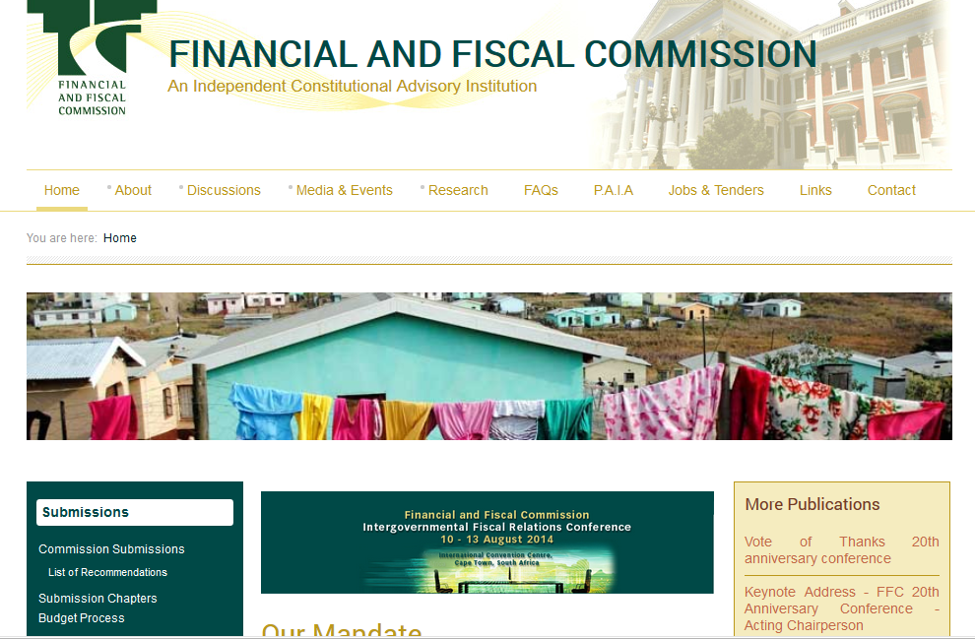
FFC Website: www.ffc.co.za

