Slide 1
Briefing on Eskom Special Appropriation Bill And Eskom Subordinated Loan Special Appropriation Amendment Bill
17 June 2015
For an Equitable Sharing of National Revenue

Slide 2
Presentation Outline
Background and Problem
  Recent developments and challenges
  Consumption Vs Production
  Consumption Vs GDP Growth
The Support Program [Sept 2014 Cabinet Package]
  R23 Billion Appropriations Bill
  Conversion of R60 Billion Subordinated Loan to Equity
An Assessment of Mechanics of the 2 Bills
Conclusion and Next Steps

Slide 3
Purpose of the Submission
The Commission is making this submission on the basis of Section 3 (1) and (2) b (i) and (ii) of the FFC Act of 1997 as amended
The purpose of this submission is to apprise the Committee on the views of the Commission with respect to the Eskom Special Appropriations Bill and the Eskom Subordinated Loan Special Appropriations Amendment Bill

Slide 4
The Problem
Electricity demand lower than expected leading to lower revenue
  On a y-o-y basis, electricity consumption declined to -2.4% in April, from 1.6% in March and a year-to-date growth rate of -0.7%.
Electricity production fell even more sharply
  Taking y-o-y growth in production down to -4.7% in April, from -0.2% in March and a year-to-date growth rate of -2.1%.
Decline in electricity consumption and production is linked to the increased spate of load shedding, itself due to significant delay in build program and inadequate maintenance
Coming on stream of the first unit of Medupi power station has led to a reduction in load shedding through May and into June
But decline in electricity consumption overall likely to continue in face of sharp increases in electricity tariffs

Slide 5
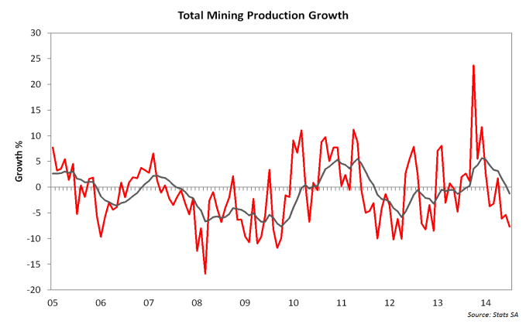
Electricity Units Consumed Vs Production Growth

Slide 6
Growth In Real GDP Vs. Electricity Units Consumed

Slide 7
Electricity demand scenarios and economic growth Forecasts
South African growth rate projection until 2017 is based on a number of assumptions. In the instance of electricity generation, forecasts assume minimum disruption to output and consumption
A number of scenarios are possible depending on the outcomes of the electricity forecasts:
  Further deterioration of electricity in 2015 could reduce economic growth by 1% in 2015
  Better than expected generation of electricity or greater energy efficiency could boost growth in 2015 by 0.4%

Slide 8
Details of Government’s Support Strategy
Eskom Special Appropriation Bill
  An amount of R23 billion is appropriated for Department of Public Enterprise (DPE) to enhance electricity generation capacity and security of supply by Eskom [1.1]
  The Bill include oversight provisions from the Public Finance Management Act (PFMA) that National Treasury can impose to ensure transparency and effective financial management of public entities [clause 1(3)]
    Enforces transparency and efficiency especially in procurement
  Eskom Subordinated Loan Special Appropriation Amendment Bill
    The subordinated loan between National Treasury and Eskom is converted to ordinary shares by Eskom to the State to the value of R60 billion [1(2)]

Slide 9
Mechanics of R23 Billion Appropriation – Cash Flow Savings
Injection helps relieve impact on consumers
Equity injection of R23 Billion
Increase Eskom’s Generation Capacity and Security of Supply
Fund Capex
R
R
Replenish Eskom Borrowing Authority – Improve gearing

Slide 10
Implications of Support Package on 2015 Budget
Eskom Special Appropriation Bill
  Government is funding the R23 billion equity injection to Eskom from the sale of state assets (substituting other assets with Eskom)
  While steps to avoid increasing the budget deficit should be commended, government’s balance sheet is still being negatively affected
  The sale of state assets is a once off cash injection and cannot be called upon again to balance off future expenditure needs
  The decision to sell state assets could be signalling that government is cautious about the impact of its support package to Eskom on the fiscal framework and demonstrates strong commitment to Budget deficit announced in Budget 2015

Slide 11
Implications of Support Package on 2015 Budget[cont.]
  Eskom Subordinated Loan Special Appropriation Amendment Bill
  The conversion to equity of the R60 billion subordinated loan is intended to strengthen Eskom’s balance sheet by reducing Eskom’s debt and improve its debt to equity ratio and other financial ratios
  The conversion is not meant to have any cash flow impact on Eskom or government and increases Eskom’s borrowing powers
  The implication of the conversion on government finances is the wavering of the R60 billion debt owed by Eskom in addition government taking an ownership stake in the entity

Slide 12
Mechanics of Loan Conversion Amendment – Gearing
Reduces Eskom Debt Principal
Reduce Eskom’s Debt Service Obligation
Improve Eskom Debt-Equity Ratio
R
R
Help defend credit rating
R
Improve Gearing
Issuance of Shorter Maturity Debt
Replenish Eskom Borrowing Authority
Close gap in Rev funding shortfall

Slide 13
Additional Government measures to Improve Fiscal Sustainability of Eskom - Guarantees
To reduce costs of borrowing and manage its credit ratings, government has progressively extended guarantees to Eskom over time (see figure below).
In the next five years Eskom is planning to raise an additional R280 billion to fund its capital infrastructure expansion programme to meet growing energy demand. By 2017/18 government guarantees to Eskom alone would have escalated to 67% of total government guarantees
Guarantees imply government commits to making loan repayments on behalf of Eskom should it default. This exposes the budget to undisclosed risk and is recorded as a liability on government’s balance sheet
BBudget Review (2015)

Slide 14
Additional Government measures to Improve Fiscal Sustainability of Eskom - Guarantees
The Commission is of the view guarantees should not be viewed as an easy option to avoid managing risks
Given that guarantees are not exposed to the same level of scrutiny in the budget process as regular spending, the Commission advises oversight mechanisms of guarantees should be strengthened to reduce the risk of unintended consequences from materialising

Slide 15
Additional Government measures to Improve Fiscal Sustainability of Eskom – Cost Reflective Tariffs
The Commission supports Government’s movement towards cost reflective tariffs as an important avenue for funding infrastructure development and as a means to use electricity more efficiently
At the same time, the decline in electricity consumption overall is likely to continue in the face of sharp increases in electricity tariffs, the extent to which will only be known on June 29th when NERSA rules on the extent to which it will accede to Eskom's request for an additional 12.6% tariff increase in July over and above the 12.7% increase already awarded to the utility
While the Commission support cost reflective tariffs, this should be considered alongside the willingness and ability of consumers to pay and likely impact on the economy and poor households so that equity and efficiency goals are achieved
Figure: Increase in Annual Eskom Domestic Tariffs; cents per KWhr

Slide 16
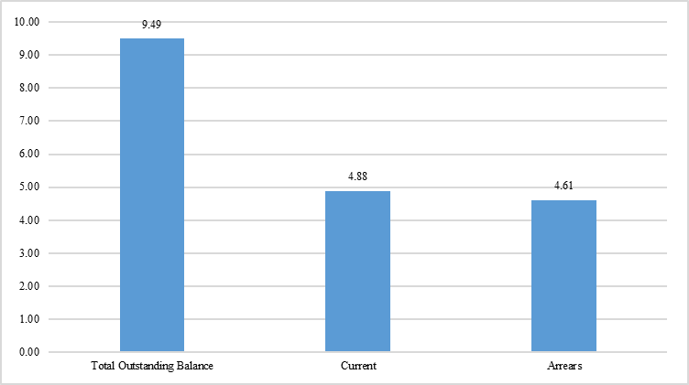
Additional Government measures to Improve Fiscal Sustainability of Eskom – revenue collection
Municipal debt to Eskom amounted to over R9 billion in 2014
Government, through National Treasury has taken active steps to encourage municipal debt repayment to Eskom. The Commission made a submission to the PC on CoGTA related to this matter

Slide 17
Summary of the Equity Injection And Loan Conversion Program
Most successful businesses seek to minimize interest expense and optimize the mix of debt instruments within their total portfolio. These proposals are no different in this regard.
  By converting subordinated loan into equity, the Amendment Bill can potentially reap considerable interest savings improved gearing
  Equity injection of R23 billion and loan conversion is a prudent business action that produces savings regardless of capital spending levels
Clause 1(3) of the Special Appropriation Bill enables the Minister of Finance to impose conditions on any part of the R23 billion appropriation and this promotes and enforces transparency and efficient management in respect of revenue, expenditure, assets and liabilities of public entities as required by section 6(1)(g) of the PFMA
The Bills keep within the spending ceilings set by the 2015 Budget Review which is prudent
  However, this cannot be a long term measure as its financed through state asset sales

Slide 18
Overall Assessment and Next Steps
The 2 Eskom bills before the committee should be viewed as part of overall strategy to improve Eskom fiscal sustainability and efficiency
The Commission believes to mitigate the risk of Eskom’s liquidity position weakening in the future and the likely implication on loan repayment, further to measures and conditions in the Bills government should:
  Speed up policy clarification and implementation on alternative energy supply options, especially IPPs roll out
  Within policy parameters, bring in private sector equity partner to inject funding and much needed expertise in Eskom and the build program
  Use guarantees sparingly and as last resort in managing risks
  DOE and Eskom Executives must communicate with customers and interested parties and find a solution regarding prepayment across all customer groupings, including holding public meetings. Over the past years, program has received virtually all negative feedback and this must be turned around if lasting fiscal viability is to be realised

Slide 19
Thank You.
Financial and Fiscal Commission
Montrose Place (2nd Floor), Bekker Street,
Waterfall Park, Vorna Valley, Midrand,
Private Bag X69, Halfway House 1685
www.ffc.co.za
Tel: +27 11 207 2300
Fax: +27 86 589 1038

