Slide 1
Local Government Fiscal Reforms
SALGA: Eastern Cape province
03 November 2015
For an Equitable Sharing of National Revenue

Slide 2
Structure of Presentation
Introduction: contextualising the relationship between SALGA and the FFC
Review of LGES
Review of Basic Services Costs
Review of Municipal Revenue Sources
Review of Infrastructure grants

Slide 3
Introdcution
What is the FFC:
  Permanent statutory body established in terms of Section 220 of Constitution
  Independent and subject only to Constitution and the law
  Must function in terms of an act of Parliament
The FFC has an MOU with SALGA and the two are driving towards the same destiny of a better LG sector.
This conference is key to the FFC as it fosters better working relations with SALGA and other stakeholders in the IGFR arena.

Slide 4
Introduction
The Commission with other key stakeholders such as SALGA, NT, COGTA, DPME are seized with reforms of the LGFF
Reforms have been sequenced as follows
  Review of LGES started in 2011 and completed in 2013. Refinements are continuing
  Review of Basic Services costs
  Review of Own Revenue Sources
  Review of Infrastructure grants

Slide 5
LGES Reforms

Slide 6




How the local government equitable share formula works
How the local government equitable share formula works (2015 Allocations)
Formula has two main parts:
  Part 1:
  Basic services component funds the delivery of free basic services and accounts for 75% of funds allocated in 2015/16
  Addresses the first objective of the formula
  Part 2:
  This part directs greater funds towards municipalities that cannot raise substantial own revenues
  Institutional component funds admin costs
  Community services component funds general municipal services
  Addresses second objective of the formula
Institutional
R4.5 billion to assist with administration costs
Free basic services
R33.8 billion
R314 per month for a package of free basic services for the 59% of SA households with an income of less than 2 old age pensions per month
These funds are only allocated to poorer municipalities (some cities can fund these from own revenues)
Community Services
R6.8 billion to fund community services

Slide 7
Advantages of the new LGES formula
Advantages of the new formula
Simpler structure, more transparent
Does not differentiate between households with or without access to basic services (rights-based approach subsidises all poor households)
Higher poverty threshold of R2300 (2011 prices)
Applies a revenue adjustment factor to the I and CS components only
New CS component funds other core municipal services
Data updated annually
More redistributive
On-going work to refine the formula
SALGA and the FFC have commissioned work to further refine the costing of basic services for the formula
Initial results show that whether the formula is over or under funded depends on how depreciation is funded
A more cost-reflective formula may reverse many of the redistributive benefits of the new formula

Slide 8
Distribution of the LES: by municipal category
Old formula - Allocation per poor household
New formula - Allocation per poor household
The old formula produced allocations per poor household that were lowest for municipalities with the least ability to raise their own revenue
South African IGFR system seeks to balance rural and urban development- with Cities burdened with unmet needs

Slide 9
Impact of the new formula)
Rural municipalities are the main beneficiaries

Slide 10
REVIEW OF BASIC SERVICE COSTS

Slide 11
REVIEW OF BASIC SERVICE COSTS
The FFC, in partnership with SALGA and COGTA are currently carrying out an exercise seeking to cost basic services.
Basic services were not properly costed in the new formula, hence the need for the review.
The first and second phases of costing of basic services have been completed, with the third phase currently underway.

Slide 12
Programme phasing
The FFC, in partnership with SALGA, has developed a model to estimate both the capital and operating costs of all municipal basic services. Phases of model
Programme phasing | Municipal Services |  | Research Cycle
 | Operating costs | Capital costs
Phase 1 | Water Sanitation Refuse removal |  | 2013/14
Phase 2 | Municipal roads and stormwater Municipal administration Municipal health services Fire-fighting services | Municipal roads and stormwater Sanitation Refuse removal Electricity | 2014/15
Phase 3 | Fire fighting services Municipal roads Storm water | Municipal administration Municipal health services Fire-fighting services | 2015/16

Slide 13
REVIEW OF MUNICIPAL REVENUE SOURCES

Slide 14
REVIEW OF MUNICIPAL REVENUE SOURCES
The Secretariat of the Commission is part of a team that is reviewing municipal revenue sources especially as they apply to metros and the cities.
This is the third in a series of reviews of the local government fiscal framework.
This review will only assess the existing own revenue sources in metropolitan municipalities.
The assessment for the other municipal groupings will follow. The reason for starting with the metros is the critical role they play in meeting government’s priorities i.e. economic development and growth.
The review will be limited to own revenue sources (property rates, service charges and levies, borrowing, sharing of the general fuel levy and internal generated revenue).

Slide 15
Review of local government infrastructure grant system

Slide 16
Why the Review and Purpose
Why Review?
  Proliferation of LG grants, the ad-hoc changes (raised by the FFC)
  Concerns over underspending (raised by parliamentary committees)
  Last wholesale review was 2003/04 – many policy developments since
Purpose of Review:
The Local Government Infrastructure Grant Review aims to make evidence-based recommendations on the current system of funding municipal infrastructure
  Articulating the principles behind the municipal infrastructure grant system and assess whether the current system of infrastructure funding effectively responds to government’s policy goals
  To objectively evaluate how efficiently public funds are being used to meet government policy objectives
    Questions to be answered in this regard include: are the grants easy to spend, suitably differentiated between rural and urban areas, and do they come with sufficient non-financial support?
Notes:
Brief summary of the Terms Of Reference (annexure A) for the review and updates on progress so far
REASONS/RATIONALE
What triggered the review? Multiple factors
NT announced it in 2013 Budget, it’s based on calls for such a review from across government over several years
For example: The FFC repeatedly raised concerns over recent proliferation of grants and also the ad-hoc nature of new grants
Parliamentary committees have questioned the under spending by municipalities on various infrastructure related grants
Sector departments and Municipalities often suggest there are certain funding gaps – disaster mitigation funding being one of these gaps
Finally no full review of LG infrastructure funding has taken place since 2003/04 when the MIG was introduced. 2011 Census showed us the on-the-ground reality has changed so clear rationale for the funding to change
PURPOSE
Improve service delivery key infrastructure at municipal level
1) Evaluates the effectiveness of grants at meeting sector and national policies (e.g is balance of backlogs vs growth correct?)
2) Analyses the efficiency that grants do this – do they deliver value for money? (are they suitably differentiated, what do performance indicators show?)
Answering these two high-level questions will lead the review to make recommendations for reform at the 2014 Budget Forum

Slide 17
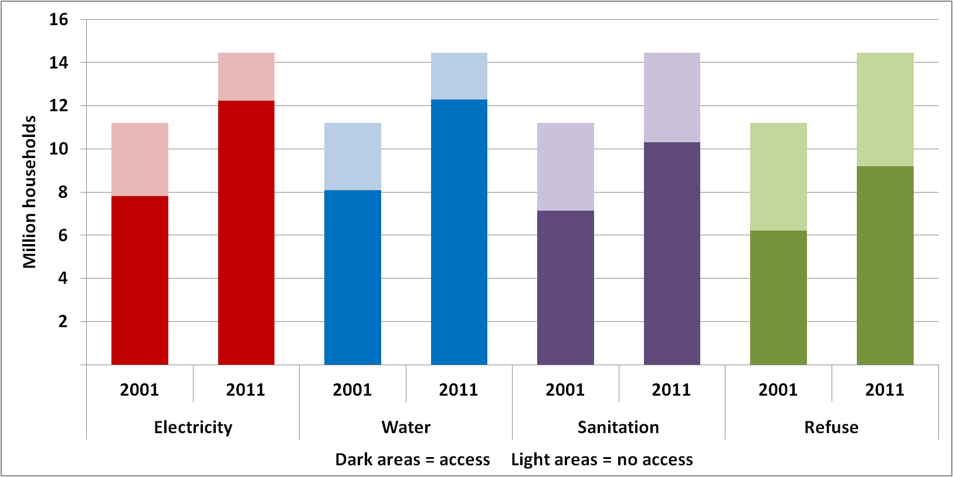
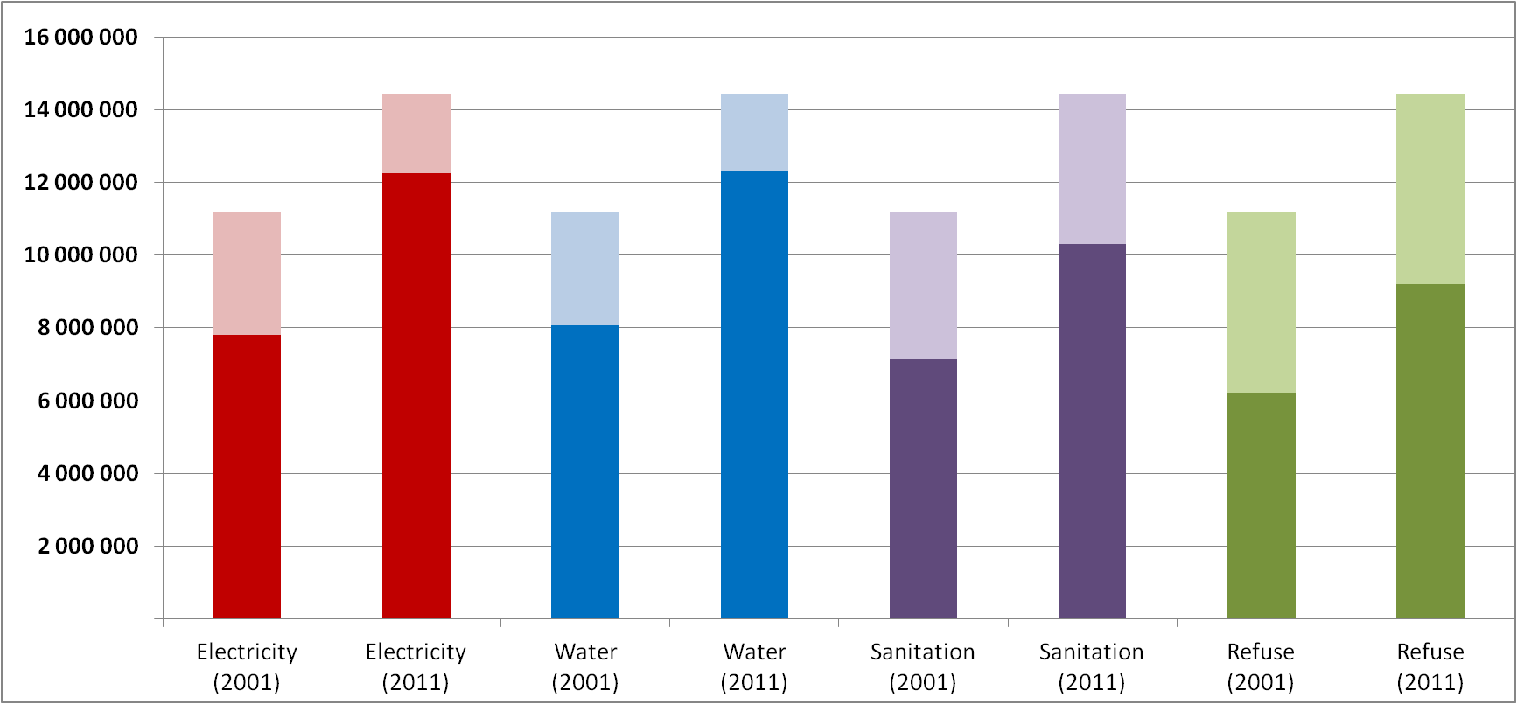
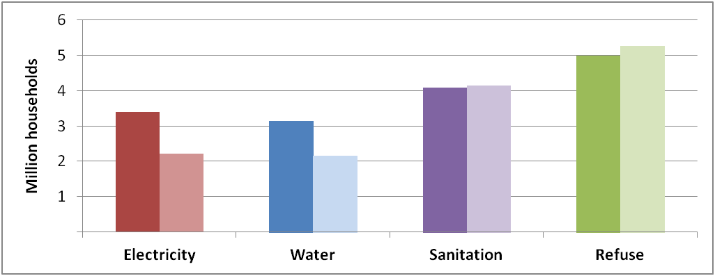
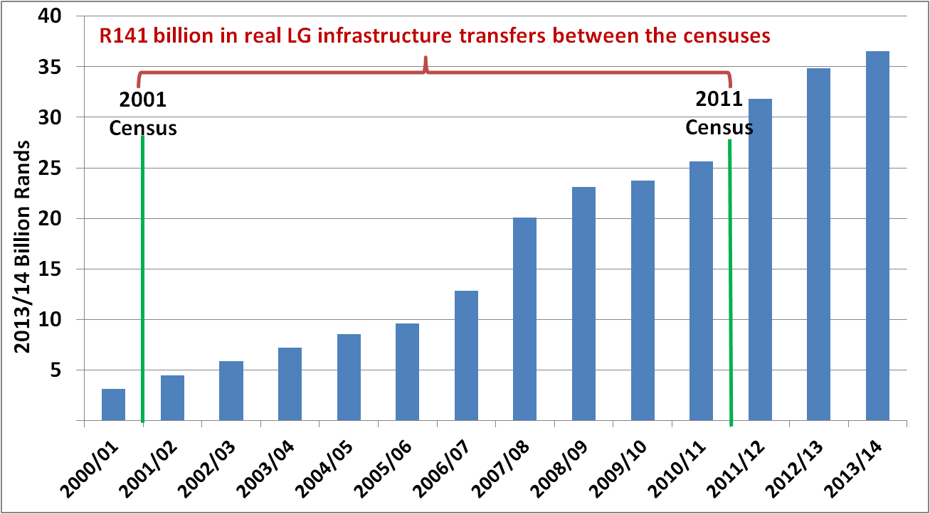
Fiscal expansion vs enduring backlogs
Households’ Access to Service (2001 to 2011)
Local Government Infrastructure Grants 2000-2012 (adjusted for inflation)
Notes:
ACCESS TO KEY BASIC SERVICES
Growth from 2001 to 2011 Census. Access has increased.
BUT population growth also significant
That means number of backlogs has not always reduced (4 million HHs without access to RDP standard sanitation)
Note this pattern varies hugely from urban metros (growth in access but huge in-migration) to rural areas
HUGE FISCAL EFFORT TOWARDS MUNICIPAL INFRASTRUCTURE
This needs to be placed in context of the huge allocations that have been made over that period, often with specific aim of eradicating such backlogs
Even after accounting for inflation the blue bar rises substantially each year. R141 billion (in today’s prices) has been allocated via LG infrastructure grants
Broader macroeconomic situation and pressure on the fiscus means increased funding akin to previous years is unlikely. Clear need to spend current allocations better to speed up backlog eradication

Slide 18
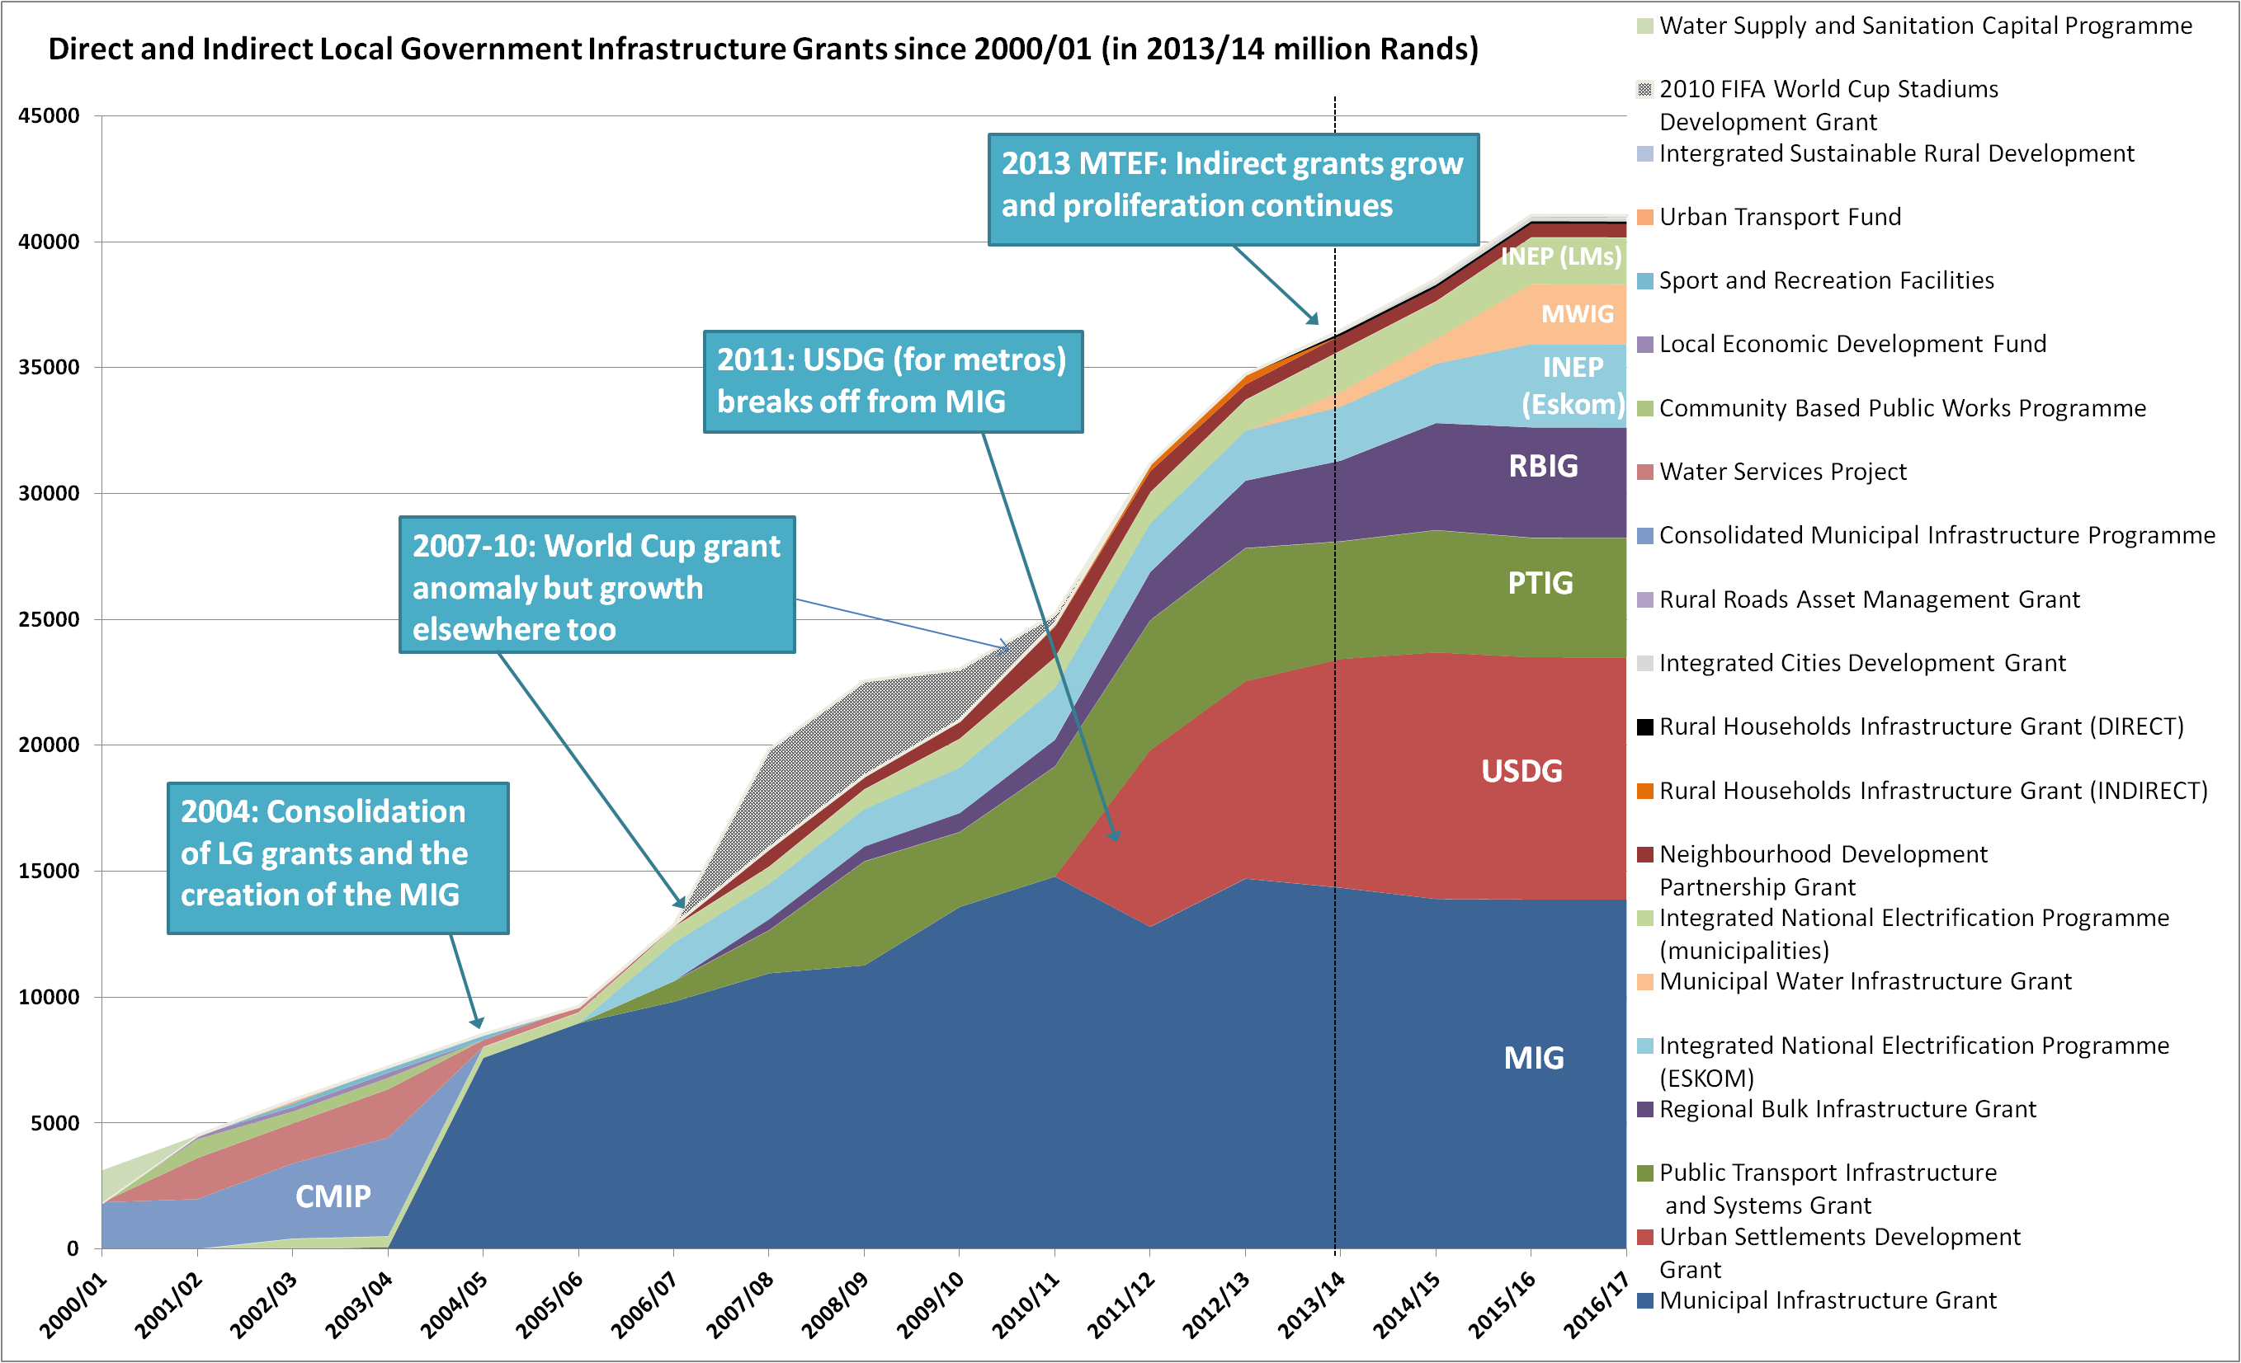
Grant Proliferation
Water Serv. Proj.
Notes:
Nicely portrays the evolution since 2000 and accompanies discussion paper documenting the evolving principles and policy ideas in that time.
Dominance of the CMIP (attempt to rationalise the number of grants) but large other grants (such as Water Services Project) still co-existed.
2004 MIG which was far more successful in consolidating the portfolio of LG infrastructure grants. Yet note the INEP grants remained distinct.
But other grants such as PTIG and RBIG started prior to 2010 and MIG increasingly less dominant.
Differentiation really kicked into gear in from 2011/12 with the creation of the USDG (following MIG cities).
Huge increases in RBIG and INEP Eskom show larger role for indirect grants – rightly or wrongly – in current MTEF
IF LANDED IN SOUTH AFRICA WITHOUT PRIOR KNOWLEDGE OF LG INFRASTRUCTURE WOULD THIS BE THE SYSTEM THEY CHOOSE? NO
SO THIS REVIEW AIMS TO RESTORE STRUCTURE AND STRATEGY TO A SYSTEM THAT EVOLVED WITH LARGELY AD-HOC DECISIONS

Slide 19
Review Method and Timelines
Based on the LGES formula review, collaborative at every stage:
Stage 1 – (Objectively) identify problems
Extensive data analysis; Identifying principles of the grant system
Working Group & Steering Committee established that includes DCOG, SALGA, DPME and FFC
Stage 2 – Verify and discuss problems (esp. implementation)
Extensive consultation and workshops
  With municipalities, national departments and other stakeholders
Stage 3 – Build consensus around solutions
Higher level consultation led by Steering Committee leading to recommendations that go to BF and Cabinet
Stage 4 – Implementation
Now until Feb 2014
Dec 2013 – July 2014
July 2014 – Oct 2014
2015 Budget (February)
Working Group (NT, DCoG, SALGA, FFC)
Steering Committee (NT, DCoG, SALGA, FFC + DPME)
Notes:
Should be familiar to many of you – LGES formula review.
Stage 1 – NEXT 4-6 MONTHS
Create an evidence base with data analysis and policy reviews to identify principles
Working group (technical help and inputs) and steering group (strategic direction)
Stage 2 – THROUGH 2014
Extensive consultation to build on stage one and verify or adapt results.
SALGA and municipalities workshops. All affected departments. And relevant professional bodies or institutions.
Stage 3 – WORK TOWARD BUDGET FORUM OCTOBER 2014
Potentially hardest – building consensus on recommendations after negotiations and briefings at highest level – Steering Committee come into their own
Stage 4 – UP TO 2015 BUDGET
Pending decisions at Budget Forum

Slide 20
Scope of the Review
Review is limited to finding ways of maximising existing resources rather than seeking solutions that require fiscal expansion
Review is limited to local government infrastructure grants
This is a review of the grants system, not municipal financing
The review will emphasise the principle of differentiation (next slide)
  Challenges such as capacity limitations, assignment of powers and functions, or municipal-level relationships are not the focus of this review
  The important matter of the assignment of powers and functions is being dealt with in another process led by DGoG, (FFC, SALGA and NT)
Local Government Week

Slide 21
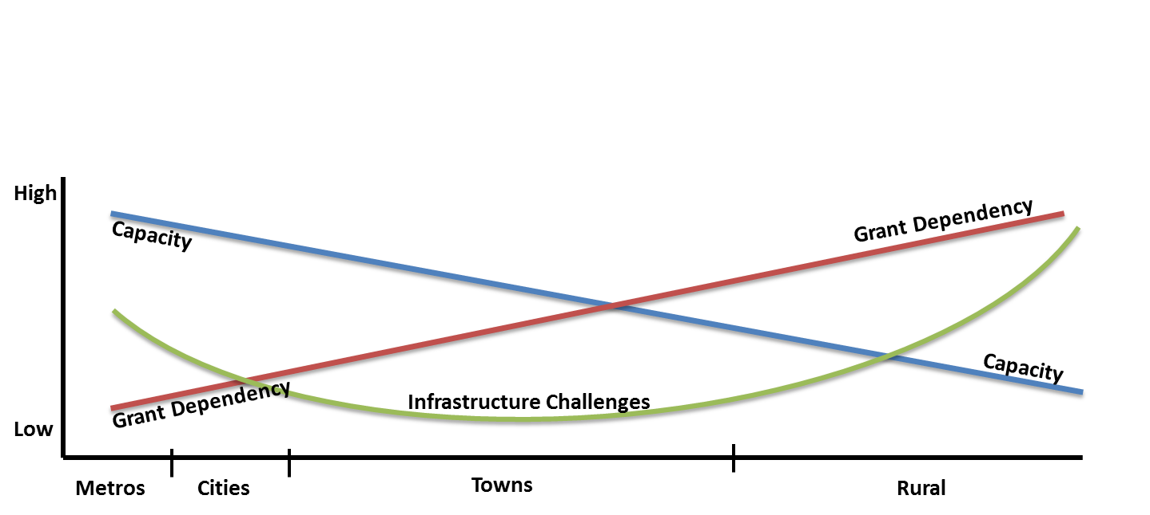
Long term vision: Grants
A municipality’s context should determine its grant system
Consolidated Urban Grant (limited conditionality, supplements capital budget)
Limit other grants to national priorities / regionally strategic projects (eg RBIG)
MIG
(allow municipal discretion, coordination with sectors, and emphasis on asset management)
Water & Sanitation
INEP
General Infrastructure & Community Services Funding
Metros
Cities
Towns
Rural
Grants to metros and secondary cities to consolidate over time

Slide 22
Infrastructure Grant Reviews Outcomes
Important outcomes from the Reviews announced in MTBPS recently are:
  The merger of a multiple of water and sanitation grants
  Introduction of a formula-driven Public Transport Network Grant
  Introducing greater differentiation for secondary cities and creating a MIG-Cities (MIG 2)
  Merging urban grants (USDG, NDPG, INEP) over the MTEF, and
  Amendments to the MIG to allow its funds to be used for the maintenance and refurbishment of municipal roads.
These reforms will, among other things, enhance the administrative efficiency and reporting; see municipalities pay more attention to asset care and maintenance; introduce predictability and transparency by a formula driven Public Transport Network grant;

Slide 23
Conclusion
The Reviews, both LES, Cost of Basic services, Own revenues and Infrastructure grants are intended to make it possible for municipalities in all parts of the country to fulfil their mandates
Differentiation/incentives are the linchpins of all the reforms
Participation by SALGA in all these reviews is important for LG and will ensure that LG issues are considered in every step

Slide 24
Thank You.
Financial and Fiscal Commission
Montrose Place (2nd Floor), Bekker Street,
Waterfall Park, Vorna Valley, Midrand,
Private Bag X69, Halfway House 1685
www.ffc.co.za
Tel: +27 11 207 2300
Fax: +27 86 589 1038

Slide 25

www.ffc.co.za
Local Government Week

