Slide 1
Withholding of LES allocations: presentation Salga Gauteng
15th May 2015
For an Equitable Sharing of National Revenue

Slide 2
Purpose of the Submission
The Commission is making this submission on the basis of Section 3 (1) and (2) b (i) and (ii) of the FFC Act of 1997 as amended
The purpose of this submission is to apprise the Committee on the views of the Commission with respect to withholding of the Local Government Equitable Share (LES) allocation by National Treasury for municipalities that have not prioritised or persistently defaulted on debt they owe to Eskom and Water Boards
Presentation on Withholding of the LES to municipalities

Slide 3
Background
On 19 February 2015 a judgement in the Free State High Court delivered a guilty verdict on a Matjhabeng Municipality Manager for persistently non-complying with court orders
On 6 March 2015, the National Treasury issued a circular on its intentions to withhold the LES allocations for Municipalities that are habitually defaulting on Eskom and Water Boards debts
At the end of March LES allocations were withheld for 59 municipalities owing to debt to ESKOM and Water Board

Slide 4
The Legal basis for the LES withdrawal
Constitution (Section 216)
Section 216 of the Constitution allows National Treasury to stop transfers to municipalities: Section 216 (1) of the Constitution provides that this can be done in the event of gross misconduct in the form of serious or persistent non-compliance with measures specified in the Constitution. In this case non-compliance means non-payment of the Eskom debt within 30 days
Division of Revenue Act (2015)
Section 17 and 18 of the Division of Revenue Act (DoRA) of 2015 and subsequent regulations prescribed in the MFMA
Enabling Legislation
The MFMA in Section 38-40, allows National Treasury to take punitive measures in the form of stopping allocations if there is persistent non-compliance with the Division of Revenue Act (2015)

Slide 5
The Legal basis for the LES withdrawal Cont’d.
But before stopping NT
must give municipality opportunity to make representation
Inform MEC for LG
Consult cabinet member responsible for making transfer
Decision to stop LES lapses after 120 days unless parliament approves/renews decision.
Parliamentary approval should be completed within 30 days of NT stoppage decision
Parliament may renew decision for no more than 120 days
Before Parliament approves or renews a decision to stop the transfer of funds to a municipality—
The municipality must be given an opportunity to answer allegations against it, and to state its case, before a Parliamentary committee

Slide 6
What is at Stake?
What is at stake is the temporary disruptions on service delivery. The municipalities are responsible for service delivery and rely albeit differently on the LES.

Slide 7
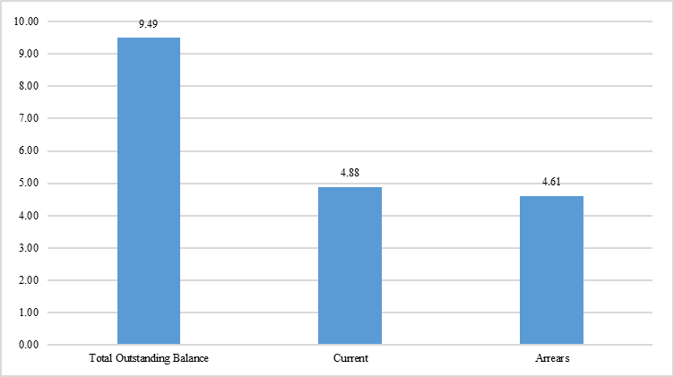
What is at Stake? the Eskom and Water Boards Debt
Municipal debt to Eskom as at November 2014 is shown in the figure below
Interestingly, the “current” municipality debt of R 4.88 billion for November was less than bulk electricity sales of R 5 billion for the same period

Slide 8
Debt Burden cont’d.
The major debtors to Eskom were municipalities in Gauteng, Free State and Mpumalanga provinces
For arrears debt, municipalities in Mpumalanga, Free State and North West top the list. Municipalities in these three provinces accounted for 82% of the total arrears

Slide 9
Debt Burden cont’d..
As of February 2015 various Water Boards were owed a total of R 3.6 billion by municipalities
Of this debt, R 1.4 billion was current debt and R 2,2 billion was in arrears
Sedibeng, Bushbuckridge and Botshelo Water boards were owed the largest amounts in terms of arrears debt, while Rand, Umgeni and Amatola Water boards were owed the largest amounts in terms of current debt

Slide 10
The Affected Municipalities
In total 59 municipalities are affected by the National Treasury circular
The majority (38 or 64%) are group B3 municipalities
The Free State and North West have the largest numbers of affected municipalities, (22% apiece)

Slide 11
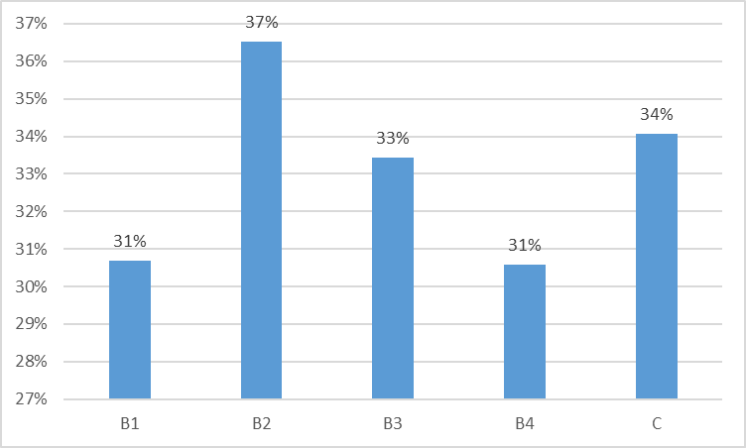
The Affected Municipalities cont’d.
On average the LES allocations accounts for between 31% and 37% of their total operating revenue
this range masks extreme rates of LES dependency for some municipalities e.g. the ratio of the LES allocations to total operating revenue was 97% for Mopani District Municipality
This huge LES dependency implies that the LES withholding would cripple operations and general service delivery

Slide 12
Issues of Principle to the Commission
Decision to withhold LES must be anchored in the constitution
Decision to withhold LES must be a last resort
Approach to debt should be fair and not one sided
The debt issue should be resolved within the IGFR system and not in courts
That compliance with the 30 day payment rule should not be enforced not only on municipalities alone but all government departments and entities,
Section 154 (1) of the Constitution prescribes support should be rendered to municipalities.

Slide 13
Issues of Concern to the Commission
Section 216 is a blunt instrument that hits the guilty and the innocent alike.
Because there is non-clarity on the assistance/intervention rendered to affected municipalities prior to the LES withdrawal. Section 154 (1) of the Constitution prescribes support should be rendered to municipalities.
That some of the municipalities affected by the LES stoppage are under administration. Who is accountable for the LES stoppage then?
If National Treasury is misinterpreted as acting on behalf of government and non-government entities to collect their debt.
That even some national and provincial government departments are not complying with the 30 day payment rule, (i.e. Section 38(1) of the PFMA (and Treasury regulations 8.2.3 (2001) and Treasury Instruction note No. 34)

Slide 14
Recent Developments
After the submission was made by the Commission a number of municipalities approached National Treasury to make payment arrangements on their debt
Out of 59 municipalities initially identified for the withholding of their LES, 16 municipalities (as of 6/5/2015) have since approached National Treasury to negotiate payment terms
The municipalities are spread over 7 provinces namely; EC, FS, KZN, LP, MP, NC and NW
The tables in the following slides detail the payment arrangements they have made with National Treasury

Slide 15
Recent Developments cont’d.

Slide 16
Recent Developments cont’d..

Slide 17
Recommendations
A proper diagnostics of the root cause of non-payment be done and if it is due to bad management, appropriate consequences should be rendered
Stricter measures should be imposed on individuals within municipalities that are responsible for continued flouting of MFMA rules.
Municipalities must produce balanced budgets and in addition the electricity and water undertakings must be ring fenced.
That IGFR forums dedicate sufficient time to find lasting solutions to the debt problems within the Local government sector.

Slide 18
Recommendations
That executives for the relevant entities implement appropriate credit controls as allowed in law
As the LES stoppage will affect the provision of basic services to poor households, the Commission would encourage that this be last resort and when proper diagnosis of the problem has been undertaken
That National Treasury applies the same pressure to all national and provincial departments that are not complying with the 30-day payment rule
The Commission would like to see a speedy conclusion of the work of the task team examining the intergovernmental debt.

Slide 19
Thank you

