Slide 1

National Treasury’s views on “Municipal Viability”
FFC Colloquium on Municipal Viability
Steven Kenyon, Intergovernmental Relations, National Treasury, 29 May 2015

Slide 2
Outline
Concept of viability and how the system should respond
Structure of the Local Government Fiscal Framework
  How redistributive is the Division of Revenue for local government?
  What is the relationship between “municipal viability” & municipal performance?

Slide 3
The concept of “municipal viability”
The concept could be considered in several dimensions, including:
Financial viability – refers to the sustainability of the municipal budget and whether the municipality is able to sustainably meet its expenditure commitments from its revenues (including own revenues and transfers)
Economic viability – refers to the ability of the economy in the area of the municipality to provide work and incomes (inclusive of government welfare and services) that enables households in the area to meet their basic needs
Institutional viability – refers to the governance and functionality of the municipality’s administration
Service delivery viability – refers to the ability of the municipality to sustainably deliver basic services to its residents that meet defined norms and standards set by national government.
  Due to historic backlogs and backlogs caused by rapid urbanization, in the South African context this form of viability should be understood as referring to the ability of a municipality to progressively meet the required norms and standards as it expands its infrastructure network.
This presentation will focus on the financial sustainability of municipalities as this falls within National Treasury’s mandate as custodian of the country’s fiscal system

Slide 4
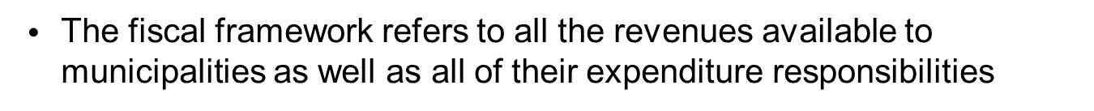
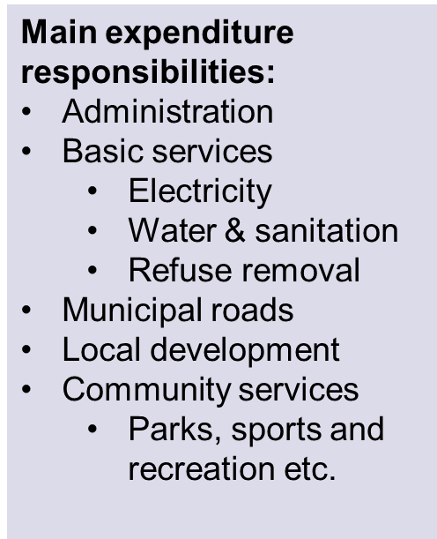
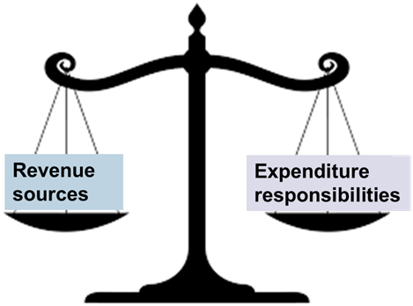
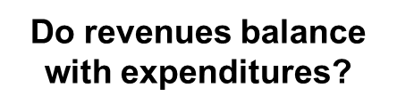
First we need to understand the structure of the local government fiscal framework
What is the local government fiscal framework?
Main revenue sources:
Municipal property rates
Service charges
  Electricity
  Water & sanitation
  Refuse removal
Sharing of the General Fuel Levy
Transfers
  Equitable share
  Conditional grants
If these balance a municipality should be “viable”

Slide 5


Composition of the local government fiscal framework
Local government fiscal framework
Services for poor households are mainly funded through transfers from national government (some cross-subsidisation within municipalities is also expected)
Services for non-poor households and businesses are paid for from own revenues
For the whole of local government, own revenues fund 75% of budgets, but in rural areas (with higher poverty rates) transfers can fund up to 80% of budgets
  Size of own revenues determined in part by high volumes consumed by non-poor HHs and businesses
National Transfers
25%
Services
Local Government
Own Revenue
75%
Poor HH
Rates & charges
Services
Middle to upper income HH and Businesses
In 2014/15 budgeted revenue for all municipalities is R310 billion
Budgets ranged in size from R44 billion in Johannesburg to R34 million in Mier
5

Slide 6
How should the LGFF respond to the uneven distribution of economic wealth in SA?
There are two broad approaches that could be taken to responding to the uneven distribution of economic activity (and hence revenue potential) across South Africa:
  Demarcations – try to demarcate rich and poor areas together so that a municipality can cross-subsidise among its communities
  Transfers – raise revenues nationally and then redistribute through transfers to municipalities with different own revenue raising potential
  South Africa uses a mix of both methodologies:
    Our municipal boundaries have been drawn to include wealthy and poor areas, but only within defined regions (towns, cities etc) that allow boundaries to also accommodate other demarcation criteria for supporting local democracy
    Subsidisation across regions is done through the Division of Revenue Act, which allocates funds from nationally raised revenues

Slide 7
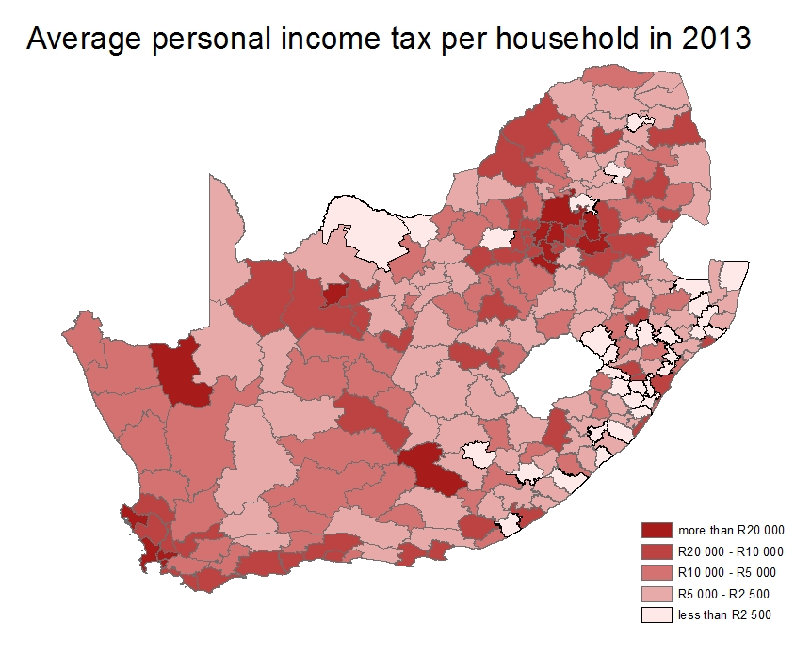
Concentrations of wealth and poverty across the SA landscape mean it would be very difficult to achieve a fair distribution of revenues through demarcations alone

Slide 8
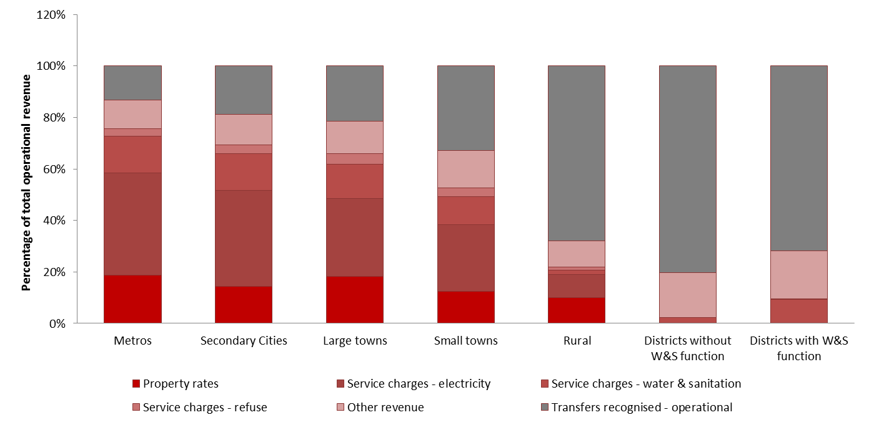
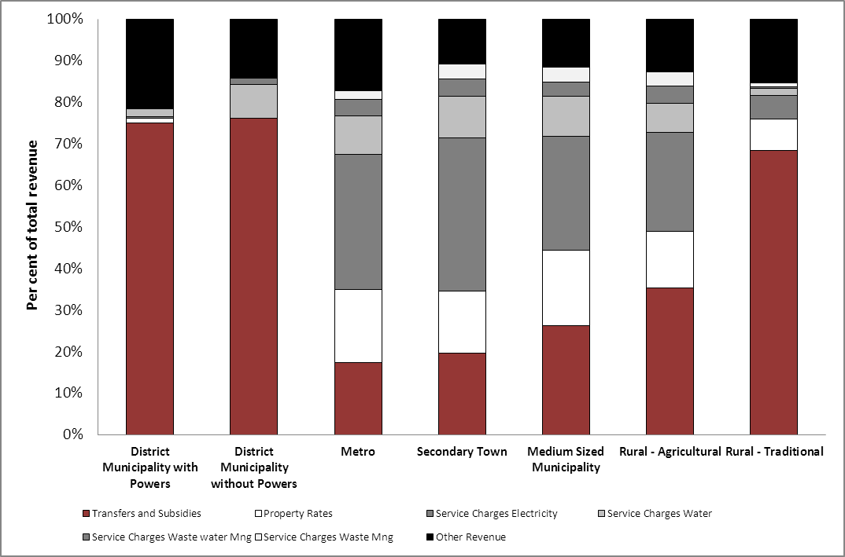
Differentiation in the LGFF
Mix of transfers and own revenues is very different in different types of municipalities
Municipalities in poorer areas have a higher proportion of funding from transfers
District municipalities are very transfer dependent as they have few own revenue sources
Contributions to municipal operational budgets per type of municipality (2012/13, audited)

Slide 9
How redistributive is the Division of Revenue for local government?

Slide 10








How the Division of Revenue is determined
The share of national revenue allocated to each sphere is based on…
The functions performed by the spheres (as set out in the Constitution):
2. Other sources of revenue available to fund these functions:
3. The total national revenue available (from tax receipts and borrowing)
  SA’s tax revenue in 2015/16 is projected at R1.2 trillion (28.4% of GDP)
  SA’s borrowing in 2015/16 will be R162.2 billion (3.9% of GDP)
  There is never enough funding to do everything we want to
National departments
Provincial governments
Municipalities
Basic education, health, social development
Basic services (water, sanitation, electricity, refuse removal)
Police and justice, higher education, social grants
National departments
Fully funded from national revenue
Provincial governments
Limited other revenue (vehicle and gambling licenses)
Municipalities
Substantial other revenue
(Property rates, service charges)
10

Slide 11
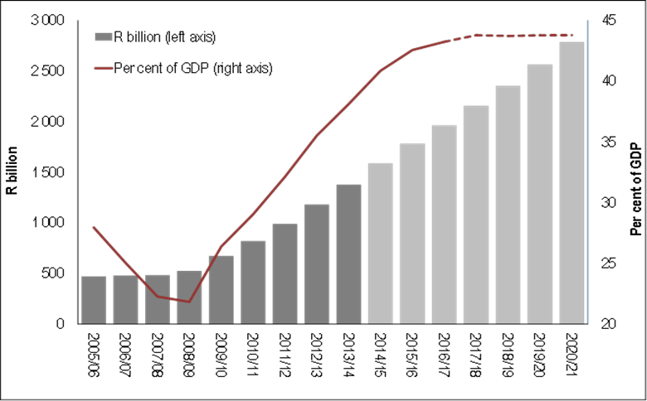
Revenue and non-interest spending
Main budget, 1996/97 – 2017/18
Context of the 2015 budget
2015/16 main budget spending is R1 222 bn and revenue is R1 049 bn (R173 bn deficit)
South Africa’s debt is growing too fast:
  We now owe R1.6 trillion, rising to R2.2 trillion in 2017.
  Interest payments are the fastest growing element of spending, and now take up 12% of revenue
Budget 2015 proposes to share the burden of fiscal consolidation:
  Continued restraint in expenditure growth
  More emphasis on cost-containment and efficiency gains, to protect key government programmes
  Moderate tax increases
  Reasonable growth in public servant’s salaries
The budget closes the gap between revenue and non-interest spending in 2016/17
National government net debt outlook, 2005/06 – 2020/21
11

Slide 12
Division of All Revenues
Division of Revenue looks very uneven if only nationally raised revenues are considered. When revenues raised by all spheres are included it looks much more balanced.
Estimated division of revenue when revenues raised by all spheres are included
Division of nationally raised revenue
Note: Data from 2013

Slide 13
Redistribution through the Division of Revenue (DoR)
DoR allocations are redistributive if areas that contribute less to national revenue receive more in transfers. For example
Johannesburg:
Accounts for 23% of SA’s personal income tax revenue but receives only 8% of transfers
Bushbuckridge:
Accounts for 0.2% of personal income tax revenue but receives 1.6% of transfers

Slide 14
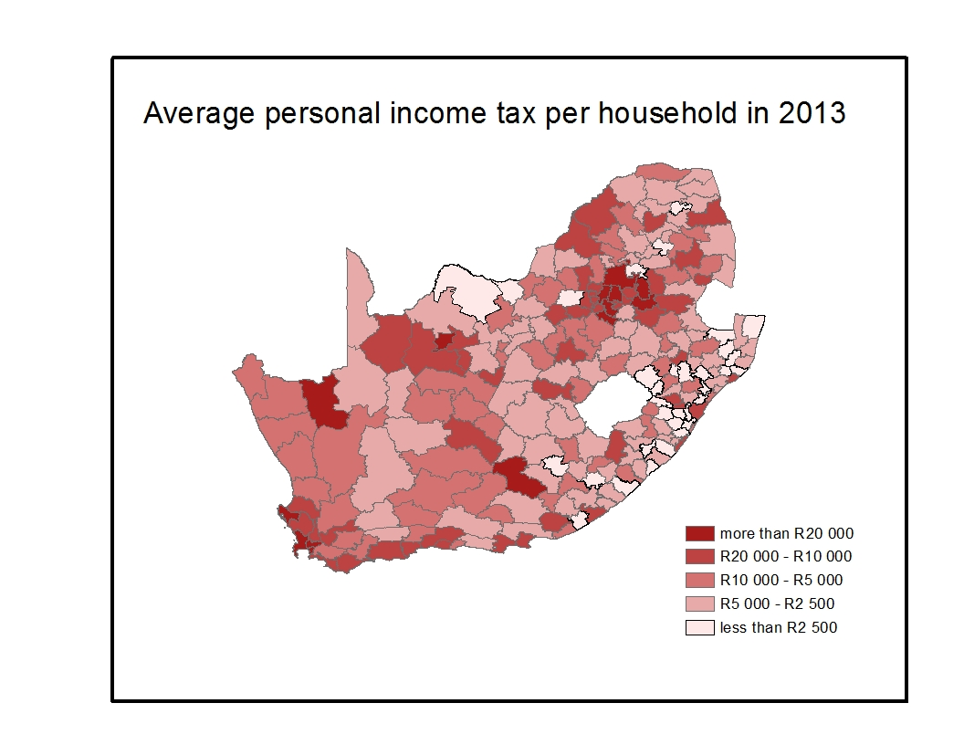
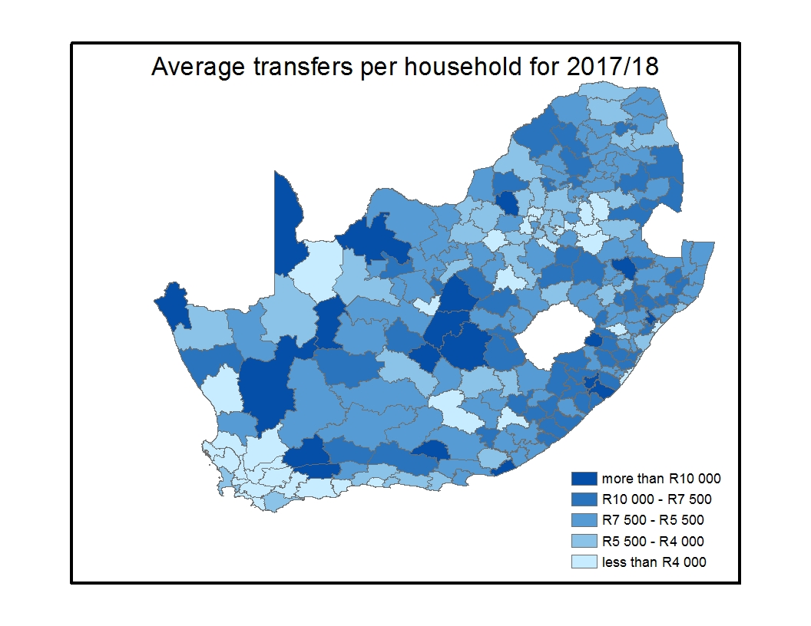
How transfers redistribute funds from the national revenue base
Tax collected nationally is redistributed to municipalities
Economic activity (and potential revenue) is concentrated in SA’s cities
Allocations to LG through the DoR direct funds to where poor HHs are located
  Higher transfer levels to poorer areas
  Largest per capita transfers to smallest municipalities as they receive allocations to subsidise institutional cost

Slide 15
How the local government equitable share formula works
How the local government equitable share formula works (2015 Allocations)
Formula has two main parts:
  Part 1:
  Basic services component funds the delivery of free basic services and accounts for 75% of funds allocated in 2015/16
  Addresses the first objective of the formula
  Part 2:
  This part directs greater funds towards municipalities that cannot raise substantial own revenues
  Institutional component funds admin costs
  Community services component funds general municipal services
  Addresses second objective of the formula
These funds are only allocated to poorer municipalities (some cities can fund these from own revenues)
Free basic services
R33.8 billion
R314 per month for a package of free basic services for the 59% of SA households with an income of less than 2 old age pensions per month
Institutional
R4.5 billion to assist with administration costs
Community Services
R6.8 billion to fund community services

Slide 16
Impact of the new formula (1 of 2)
Old formula - Allocation per poor household
New formula - Allocation per poor household
The old formula produced allocations per poor household that were lowest for municipalities with the least ability to raise their own revenue
The new formula corrects this with a much more redistributive structure
(figures presented here exclude the impact of the phase-in)

Slide 17
Advantages of the new LGES formula
Advantages of the new formula
Simpler structure, more transparent
Does not differentiate between households with or without access to basic services (rights-based approach subsidises all poor households)
Higher poverty threshold of R2300 (2011 prices)
Applies a revenue adjustment factor to the I and CS components only
New CS component funds other core municipal services
Data updated annually
More redistributive
On-going work to refine the formula
SALGA and the FFC have commissioned work to further refine the costing of basic services for the formula
Initial results show that whether the formula is over or under funded depends on how depreciation is funded
A more cost-reflective formula may reverse many of the redistributive benefits of the new formula

Slide 18
Impact of the new formula (2 of 2)
Rural municipalities are the main beneficiaries
Large towns include: Knysna, Randfontein, Kokstad, Mahikeng and Makana
Small towns include: Beaufort West, Bela Bela, Vetersdorp and Mier
Rural municipalities include: Bushbuckridge, Ntabankulu, uPhongolo and Greater Taung

Slide 19
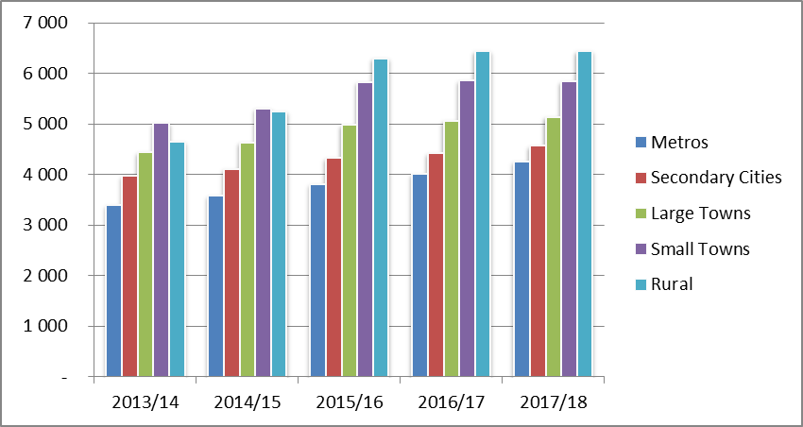
LGES Allocations – Post Phase In 5 Year (1 of 3)
2013/14 - 2017/18 (5 Years) Post Phase-In Allocation per poor HH (If all functions assigned to Metros and LMs)
Note: data in these slides is recalculated so that water and sanitation funds are allocated to local municipalities

Slide 20
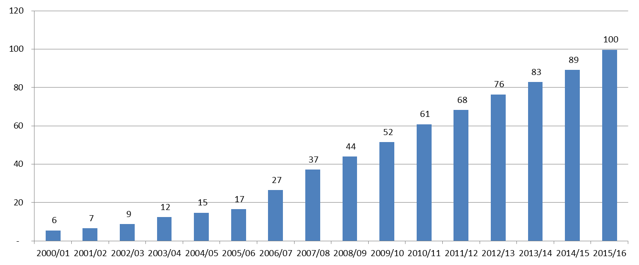
Changes in transfers to LG
2000:
3% of division of revenue allocated to local government
1998 White Paper estimated that 90% of local spending funded from own revenues, 10% from transfers
2015:
9.1% of division of revenue allocated to local government
75% of local spending funded from own revenues and 25 % from transfers
Value of transfers to local government, 2000 – 2015 (R Billions)
Note: amounts quoted are nominal values
Have increased transfers led to a corresponding improvement in delivery?

Slide 21
What is the relationship between “municipal viability” & municipal performance?

Slide 22
Summary of reasons municipalities face budget shortfalls
Presentation so far has examined LGFF structure
Assignment of functions
Tariffs not
cost-reflective
Budgeting and operational decisions within municipalities also have a large impact on delivery outcomes
Non-priority wants
Allowed taxes
Poor billing
Priority of LG in vertical division and structure of LGES formula and grants
Poor debt management
Revenue forgone
Theft and graft
Bad management
Demand for other important services
Policy constraints on fiscal potential
Inefficient procurement
Revenue lost due to lack of fiscal effort
Under-spending
Conditional transfers
Non-priority services
(including higher service standards)
National and provincial mandates
Conditional transfers
“Leakages”
Borrowing
Service charges
Borrowing
Other important services
Service charge revenue
Effective and efficient expenditure
Non-priority services
Demand for basic services
Mandates
Rates and taxes
Other services
Rates and taxes
Basic services
Equitable share
Mandates
Institutional set up
Equitable share
Institutional set up
Basic services
Institutional set up
Community needs and wants
LG Fiscal Framework
Revenue choices and collection
Budgeted expenditure choices
Managing delivery
Actual service delivery

Slide 23
Alignment between the structure of the LGFF and municipal budgets
The structure of the LGFF focuses on basic services:
  75% of the LGES formula is based on free basic services
  Charges on basic services are the largest source of own revenues
  This is in line with the Constitution’s requirement that Municipalities prioritise “basic needs and social and economic development” in their budgets, administration and planning (S53)
  If municipal budgets are similarly focused on basic/trading services then the LGFF and municipal budgets will align well and it will be relatively easy to evaluate if funding is adequate
Functions funded by the LGFF
Functions funded in the Municipal Budget
Basic services
?
Municipal decision
Funds
Admin costs
and other services

Slide 24
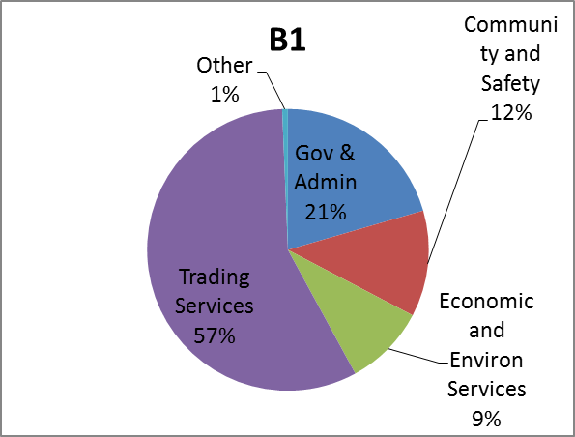
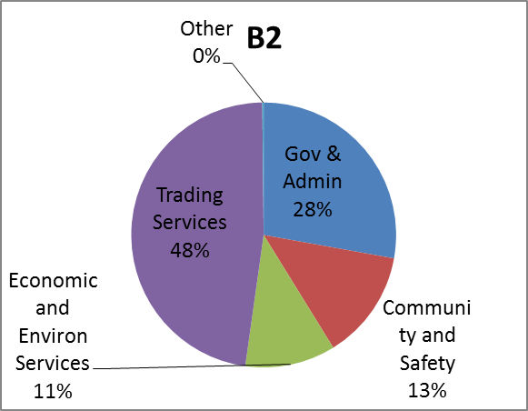
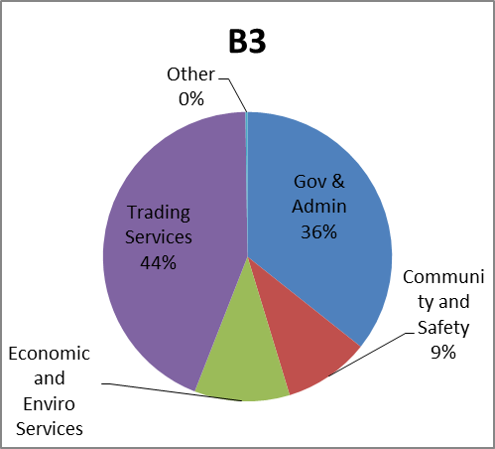
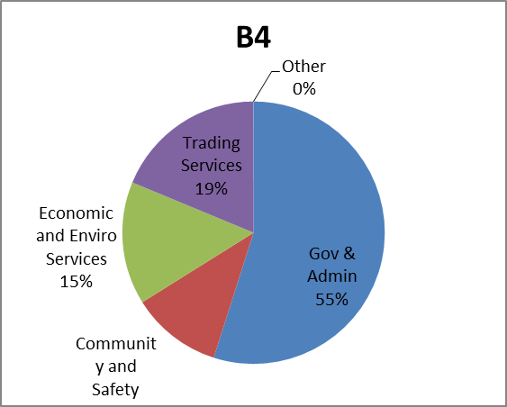
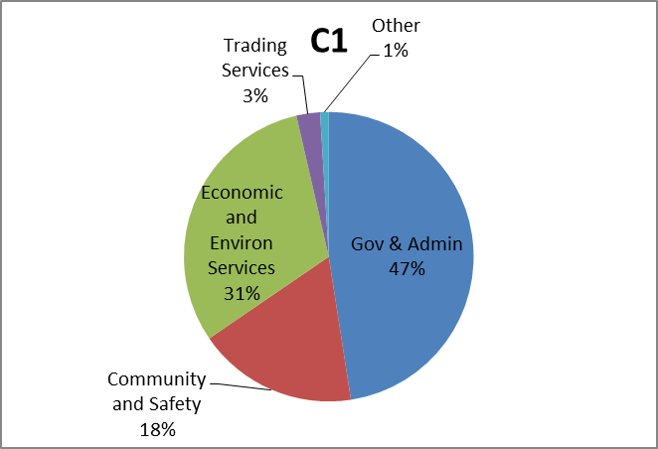
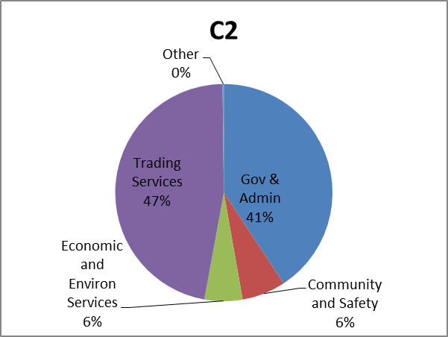
Composition of operating expenditure by type of municipality, 2015/16
Average budget size: R2.1bn
Average budget size: R647m
Average budget size: R215m
Average budget size: R203m
Average budget size: R201m
Average budget size: R616m

Slide 25
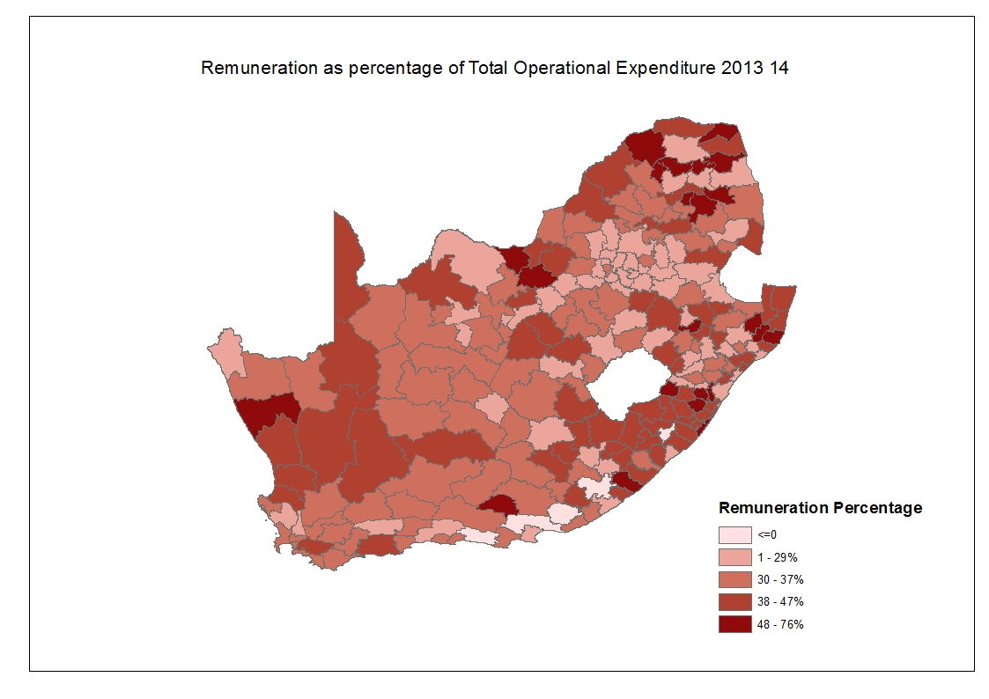
Most municipalities spend well above the 30% norm for staff costs

Slide 26
2013/14 state of local government finances highlights
Between 2013 and 2014, the number of municipalities in financial distress decreased from 95 to 86 municipalities but is still too high.
The assessment found the following:
i. 40 municipalities reported negative cash balances, while 206 have poor cash coverage;
ii. excessive overspending on operational budgets recorded in 13 municipalities;
iii. significant underspending on operational budgets in 85 municipalities;
iv. 210 municipalities recorded high underspending on capital budgets;
v. 158 municipalities reported debtors over 30 per cent of their total revenue;
vi. excessive growth in debtors is recorded under 42 municipalities;
vii. significant creditors reflected in 74 municipalities,

Slide 27
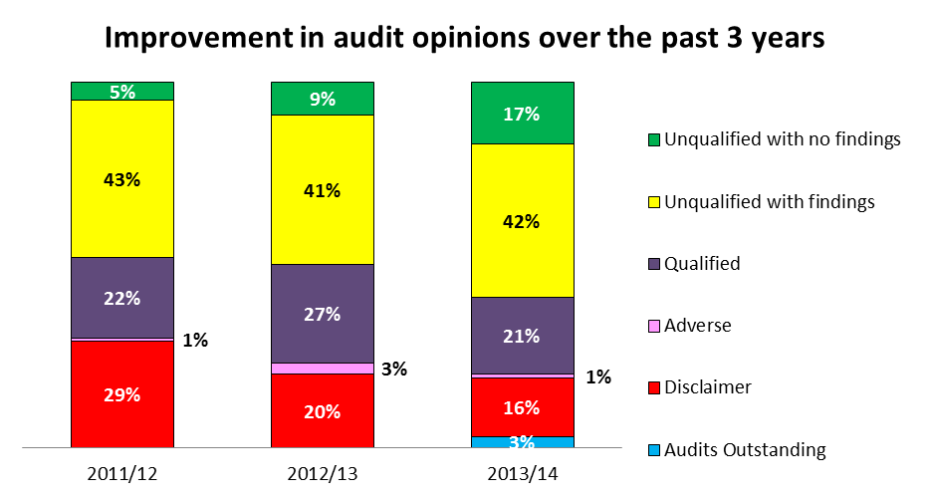
State of local government finances: audit outcomes - 3 year trend
  Importantly, unqualified audit opinions does not constitute a successful municipality, nor does it translate into service delivery.

Slide 28
Governance : Acting MMs and CFOs positions
Status of acting MM’s and CFO’s between 2013 and 2014.
The level of vacancies in key managerial positions is more prevalent in Limpopo, Mpumalanga and Eastern Cape provinces.
There were a number of instances where both the Municipal Manager and Chief Financial Officers were vacant in these provinces.
The AG reported higher utilisation of consultants in the Eastern Cape, Mpumalanga and Northern Cape provinces. Excessive utilisation of consultants is discouraged.

Slide 29
Comparisons between similar municipalities also show how different choices lead to different results (1 of 2)
Thulamela LM and Makhado LM are both B4 municipalities in Limpopo with comparative numbers of hholds (156 594 and 134 889 respectively), budget sizes, and poverty ratios (75% and 76% respectively).
 | Thulamela | Makhado
Employee costs | 44% of Opex | 32% of Opex
Governance and administration | 45% of Opex | 62% of Opex
Operating surplus | R161m operating surplus | R2m operating deficit
Capital budget | Capital budget of R165.4 million, (88% grant funded) | No capital budget submitted for 2013/14, despite R109 million in capital transfers
Notes |  | Equitable share withheld in March 2014

Slide 30
Comparisons between similar municipalities also show how different choices lead to different results (2 of 2)
Tswelopele LM and Mafube LMs are both B3 municipalities in the Free State with comparative numbers of hholds (11 992 and 16 460 respectively), budget sizes, and poverty ratios (66% and 67% respectively).
 | Tswelopele | Mafube
Employee costs | 30% of Opex | 24% of Opex
Governance and administration | 49% of Opex | 37% of Opex (24% of Opex spent on community safety)
Operating surplus | R2.7m operating deficit | R200 000 operating surplus
Capital budget | Capital budget of R29.4 million, (98% grant funded) | Capital budget of R25.6 million, (91% grant funded)
Notes |  | Equitable share withheld in March 2014

Slide 31
Conclusion
The Division of Revenue is intended to make it possible for municipalities in all parts of the country to be financially sustainable
Whether municipalities achieve this or not depends on a range of other factors, many of which are in the control of municipalities themselves

Slide 32
THANK YOU

